Slide 1

Database Overview
MUSADAQ MANSOOR

Slide 2

Database
The term database describes a collection of data organized in a manner that allows access, retrieval, and use of that data.
The database evolved from a computer file system.

Slide 3
Purpose of database
Reduces data redundancy to large extent
Controls data inconsistency
Facilitates sharing of data
Provides data security

Slide 4
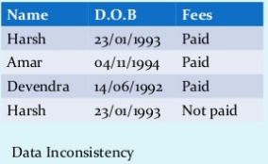
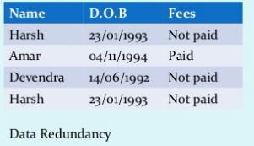
Data Redundancy Vs. Data Inconsistency

Slide 5

Interaction with Database
Following are the common people which interact with database
Database Programmers
Database Managers
Users ( based on their access level )

Slide 6
Database Implementation Level
INTERNAL (PHYSICAL) LEVEL
It describe how data is actually stored on the storage medium.
It is closest to database programmer.
It is lowest level of abstraction.
CONCEPTUAL LEVEL
It describes what data is actually stored in the database.
It is closest to database manager.
It is intermediate level of abstraction

Slide 7
Database Implementation Level ( continue )
EXTERNAL LEVEL ( VIEW LEVEL )
It describes the way in which data is viewed by individual user.
It is the level closest to users.

Slide 8
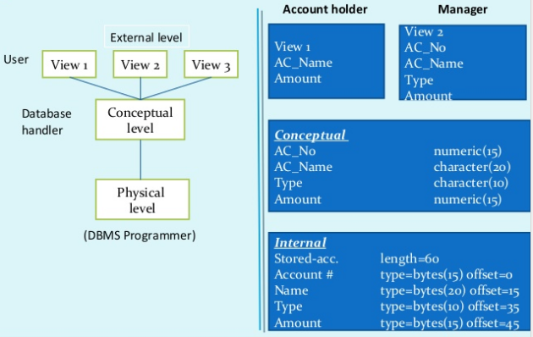
Levels of Abstraction

Slide 9
Types of Databases
Databases can be classified according to:
Number of users
Database location(s)
Expected type and extent of use
Single-user database supports only one user at a time
Desktop database: single-user; runs on PC
Multiuser database supports multiple users at the same time
Workgroup and enterprise databases

Slide 10
Types of Databases
Centralized database
data located at a single site
Distributed database
data distributed across several different sites
Operational database
supports a company's day-to-day operations
transactional or production database
Data warehouse
stores data used for tactical or strategic decisions

Slide 11
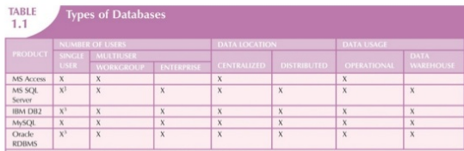
Types of Databases

Slide 12
DBMS
Data Base Management Systems (DBMS)
A database management system (DBMS) is a collection of programs that enables users to create and maintain a database.
Manages structure and controls access to the data.
The DBMS essentially serves as an interface between the database and end users or application programs, ensuring that data is consistently organized and remains easily accessible.

Slide 13
What DBMS handles?
The DBMS manages three important things
Data
Database engine, that allows data to be accessed, locked and modified
Database schema, which defines the database’s logical structure.

Slide 14
RDBMS
What is a relational database?
A relational database is a type of database that stores data in tables and uses relationships between the tables to organize the data.
To access and manipulate the data in a relational database, users can use structured query language (SQL).
SQL allows users to create, modify, and query the database using commands such as SELECT, INSERT, UPDATE, and DELETE.

Slide 15
Relational Database Definitions
Entity: Object, Concept or event (subject)
Attribute: a Characteristic of an entity
Row or Record: the specific characteristics of one entity
Table: a collection of records
Database: a collection of tables

Slide 16
The Relational Database Model
Developed by E.F. Codd, C.J. Date (70s)
Table = Entity = Relation
Table row = tuple = instance
Table column = attribute
Table linkage by values
Entity-Relationship Model

Slide 17
The Relational Model
Each attribute has a unique name within an entity
All entries in the column are examples of it
Each row is unique
Ordering of rows and columns is unimportant
Each position (tuple) is limited to a single entry.

Slide 18
CRUD
Refers to the most common Database Operations:
Create
Read
Update
Delete

Slide 19
Database Tables
Tables represent entities
Tables are always named in the singular, such as: Vehicle, Order, Grade, etc.
Tables in database jargon are “flat files”, dBase or Spreadsheet like..

Slide 20
Attributes
Characteristics of an entity
Examples:
Vehicle (VIN, color, make, model, mileage)
Student (SSN, Fname, Lname, Address)
Fishing License (Type, Start_date, End_date)

Slide 21
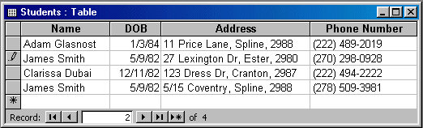
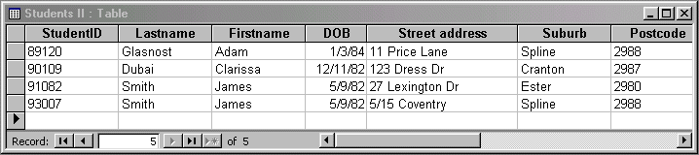
Database Table Example
Figure 1: A simple – and flawed – table design.
Figure 2: An improved database table..

Slide 22
Database Views
A View is an individual’s picture of a database. It can be composed of many tables, unbeknown to the user.
It’s a simplification of a complex data model
It provides a measure of database security
Views are useful, primarily for Read-only users and are not always safe for CREATE, UPDATE, and DELETE

Slide 23
Types of Keys
PRIMARY KEY
A primary key is a field (or set of fields) that uniquely identifies each record in a table.
The primary key is used to ensure data integrity and to establish relationships with other tables.
FOREIGN KEY
A foreign key, on the other hand, is a field that refers to the primary key of another table.
It is used to establish a link between the two tables and to enforce referential integrity.

Slide 24
Relational Database Management System (RDBMS)
Student Name | Student Email | Course Number
John Doe | John.doe@example.com | 1
Smith | smtih@example.com | 2
Course Number | Course Name
1 | Office Management Tools
2 | SME

Slide 25
RDBMS Examples
Microsoft Office Access
Microsoft SQL Server
Mongodb
MySql

Slide 26
Classification of Databases
Relational Database
No Relational Database

